Slide 1
CS 110 - Professional Practices in IT Instructor Name : Dr Tariq Umer Email : tariqumer@cuilahore.edu.pk

Slide 2
WEEK -1 Introduction to Ethics and Its Principles

Slide 3
Topics Covered in this Lecture
Introduction to Course
Ethics , Definition and concept
Morality in Islam
Professional and Social Ethics

Slide 4
Learning outcomes of this Lecture
To understand the concept of Morality and Ethics
Learning Ethics Concept in Islam and daily life.
To know different types of Ethical challenges new era.
How to manage personal Ethics in Society and Profession

Slide 5
Course Overview
90 Minutes | Ethics definition and concept
90 Minutes | Ethics definition and concept
90 Minutes | Ethics in Islam
90 Minutes | Video Lecture on Ethics in Islam
90 Minutes | Ethics Implementation officer and his Role
90 Minutes | Code of Ethics in IT (ACM, IEEE)
90 Minutes | Code of Ethics in IT (ACM, IEEE)
90 Minutes | Privacy Risks and Principles
90 Minutes | Privacy Risks and Principles (Examples)
90 Minutes | Privacy Issues in real life
90 Minutes | Expectation of Privacy, and Surveillance Technologies
90 Minutes | Working Environments and Ethical Crimes
90 Minutes | Cyber Crime
90 Minutes | Cyber Crime Issues and facts
90 Minutes | Cyber Crime Laws in Pakistan
90 Minutes | Cyber Crime Laws in Pakistan
90 Minutes | Group discussion on key issues
90 Minutes | Freedom of Speech
90 Minutes | Freedom of Speech discussion
90 Minutes | Job Discrimination
90 Minutes | Job Discrimination
90 Minutes | Intellectual Property
90 Minutes | Intellectual Property Factors
90 Minutes | IPO role in Pakistan
90 Minutes | Plagiarism
90 Minutes | Research Ethics and Plagiarism
90 Minutes | Research articles on Ethics

Slide 6
What does Professional Practices mean to you?

Slide 7
Definitions
Ethics – A branch of philosophy concerned with ways of thinking philosophically about morality, and moral judgment.
Morality – Human conduct and character referring to “those acts which it makes sense to describe as right or wrong, good or bad.”
Moral Judgment – Judgments based on considerations of how other people are to be treated, and how others interests are to weigh against their own.
Notes:
Ethics: are principle or standards of behavior that are defined and adopted by a group, organization, or profession. They are more formalized and can vary depending on culture, societal or professional norms. Ethics may be written into code of conducts or professional standards. For example, medical ethics guide the behavior of healthcare professionals.
Morals: are personal beliefs or principles that an individual holds regarding what is right or wrong. Morals are often shaped by personal experience, upbringing, religion or philosophy. They reflects individual sense of right and wrong independent of external standards or rules. For instance, someone might believe it’s morally wrong to lie, based on their personal convictions.

Slide 8
Open-Ended Questions?
What are ethics?
Are ethical decisions important?
What happens without ethics?
What is the relation between society – ethics – morals – moral judgment?

Slide 9
Examples of Ethical Decisions
An American journalist, the first, to visit the Soviet Union after the Chernobyl accident found a very provocative story. He was taken on a tour of the plant with some American engineers after the 1986 explosion. What he found out about what happened the night the reactor exploded was frightening. It seems that night two of the engineers were playing around with one of the reactors, in what later the Soviets described as an "Unauthorized experiment." The engineers were trying to see how long a turbine would free-wheel if they took the power off it. To do this they had to take reactor four off-line. They by- passed six different security systems with warning lights saying "extremely dangerous do not continue." They shut off the alarms rather than the experiment. The engineers even padlocked open the valves on the reactor so they wouldn't automatically close. These engineers were two of the people considered excellent in their field. If they had been in America they would have been seen as Yale, Harvard, or MIT, graduates. They would have had 4.0 GPA's and highly revered.

Slide 10
What ethical decisions were involved in this story?
What kind of ethical decisions did the engineers make?

Slide 11
Take out a piece of scrap paper!
Do not put your name on the paper, this is anonymous!
Would you cheat on an important exam? “Yes or No”
A survey of American students showed that 65% would cheat!
Were you truthful? Is it ethical to answer truthfully? Who gets hurt when people are unethical? What if GM cheated you when they built your car?

Slide 12
Morals
Moral code
Set of rules
Establishes boundaries of generally accepted behaviour
Different rules often have contradictions
E.g. Caught friend cheating? Personal privacy?
Morality
Social conventions about right and wrong
Widely shared
Form basis for an established consensus
Morals
Principles on which one’s judgement of right and wrong are based
Not related to professional work

Slide 13
Morality
Morality may vary by:
Age
Cultural group
Ethnic background
Religion
Life experiences
Education
Gender

Slide 14
Where does morality come from?
Parents
Religion
Peers
Technology

Slide 15
Parents
Parents instill ethics and morals in children. Example: A child yells at their friend – calling them a name.
How does the parent respond?
Other ways?

Slide 16
Religion
Most religions set guidelines on how to make moral judgments.Example: In the Christian religion the ten commandments serve as guidelines for making ethical and moral judgments.
What do Muslims, Hebrews, and other religions use?

Slide 17
Peers
Friends effect your moral judgments. Example: A friend or colleague might coax you to use drugs.
Peer pressure can sometimes cause people to make moral and ethical decisions.
Others?

Slide 18
Technology
Technology provides many opportunities to make moral and ethical decisions. Example: Copying computer games and violating copyright laws.
Does having a radar detector give you the right to break the law and speed?
Is it ethical to slash and burn the rain forests to feed more people?
Should you drive your car to work or school when it is in within waling distance?

Slide 19
Right, Wrong and Grey areas?
Unclear situations in ethics, many times they are personal and hotly debated in politics.
Black and white – Fairly clear – straight forward, most people feel the same way about: stealing, murder, honesty, charity.
Others?

Slide 20
Ethics
Ethics
Set of beliefs about right and wrong behavior within a society
Ethical behavior conforms to generally accepted norms; many of which are almost universal
Guiding principals of conduct for an individual/group
Influenced by Profession, field, organization
Related to professional work
Virtues
Habits that incline people to do what is acceptable (fairness, generosity, Loyalty etc)
Vices
Habits of unacceptable behavior (vanity, Greed, anger, envy etc.)
Virtues and vices define a personal value system
Scheme of moral values

Slide 21
Integrity
Integrity is a cornerstone of ethical behaviour
People with integrity:
Act in accordance with a personal code of principles
Extend to all the same respect and consideration
Apply the same moral standards in all situations
Lack of integrity emerges if you apply moral standards differently according to situation or people involved
Many ethical dilemmas are not as simple as right versus wrong

Slide 22
Law
A system of rules that tells us what we can and cannot do
Enforced by a set of institutions (the police, courts, law-making bodies).
Legal acts are acts that conform to the law.
Moral acts conform with what an individual believes to be the right thing to do.
Laws can proclaim an act as legal, although many people may consider the act immoral

Slide 23
Why Professional Issues in IT?
Computing is one of the key factors for progress in various areas nowadays
It has transformed the way we live, learn, work, and play.
Advances in computing & related technologies will help improve business, commerce, manufacturing, communication, research, education, and social interaction.
This improvement will provide us with new tools which will definitely be a vehicle for economic growth

Slide 24
Why Professional Issues in IT?
Computers/IT/Software sector important for mission-critical applications ($$$ + Life/Death involved here)
Something goes wrong, who to blame ???
Developed countries vigorously follow Laws/Standards/Ethics, etc. related to computing
Professionals working in CS/IT with no knowledge of these aspects risk the chance of jobs, or procurement of contracts in developed countries.

Slide 25
Recent scandals in IT companies
Satyam Computer Services (India)
Hewlett Packard
Computer Associates International
IBM
Enron Accounting Scandal
Read it by yourself

Slide 26
Why Fostering Good Business Ethics Is Important?
To gain the good will of the community
To create an organization that operates consistently
To foster good business practices
To protect organization/employees from legal action
To avoid unfavorable publicity
Notes:
Foster = Encourage

Slide 27
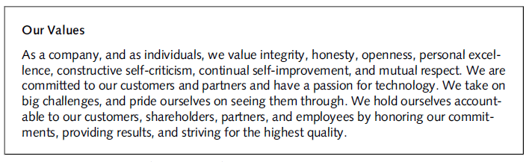
Microsoft’s statement of values

Slide 28
Corporate ethics/Compliance officer
Provides vision and leadership in business conduct
Should be well-respected, senior-level manager who reports directly to the CEO
Ensures ethical procedures are put in place
Creates and maintains ethics culture
Is responsible for key knowledge/contact person for ethical issues
CEO has :
Responsibility for compliance
Responsibility for creating and maintaining the ethics culture
Responsibility for being a key knowledge and contact person

Slide 29
Code of Ethics
Highlights an organization’s key ethical issues
Identifies overarching values and important principles
Focuses employees on areas of ethical risk
Offers guidance for employees to recognize and deal with ethical issues
Provides mechanisms to report unethical conduct
Help employees abide by the law, follow necessary regulations, and behave in an ethical manner

Slide 30
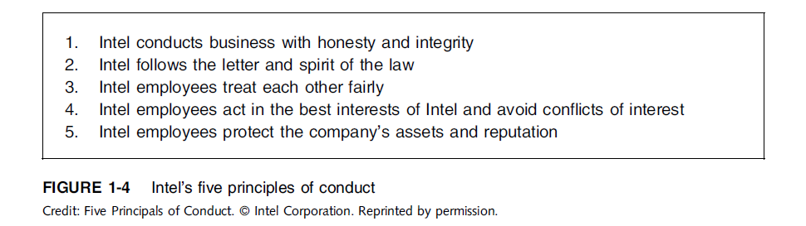
Intel Code of Ethics

Slide 31
Code of Ethics and Professional Conduct
A good example of a code of ethics is the Code of Ethics and Professional Conduct of the Association for Computing Machinery, an organization of computing professionals that includes academics, researchers, and practitioners/
No one should enter or use another’s computer system, software, or data files without permission. One must always have appropriate approval before using system resources, including communication ports, file space, other system peripherals, and computer time.
Designing or implementing systems that deliberately or inadvertently demean individuals or groups is ethically unacceptable.
Organizational leaders are responsible for ensuring that computer systems enhance, not degrade, the quality of working life. When implementing a computer system, organizations must consider the personal and professional development, physical safety, and human dignity of all workers. Appropriate human-computer ergonomic standards should be considered in system design and in the workplace.

Slide 32
Acceptable Use Policies
Many organizations that provide technology services to a group of constituents or the public require agreement to an acceptable use policy (AUP) before those services can be accessed.
Similar to a code of ethics, this policy outlines what is allowed and what is not allowed while someone is using the organization’s services.
“Borrowing” someone else’s login ID and password is prohibited.
Using the provided access for commercial purposes, such as hosting your own business website, is not allowed.
Sending out unsolicited email to a large group of people is prohibited.

Slide 33
Ethics in IT
Public concern about the ethical use of information technology includes:
E-mail and Internet access monitoring
Downloading in violation of copyright laws
Unsolicited e-mail (spam)
Hackers and identify theft
Students and plagiarism
Cookies and spyware

Slide 34
Ethics & Morality in Islam

Slide 35

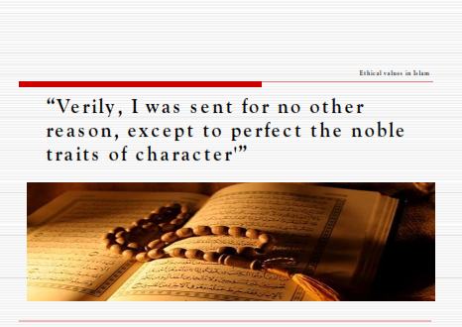
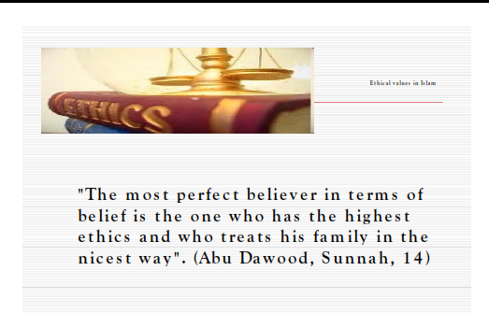

Slide 36



Slide 37
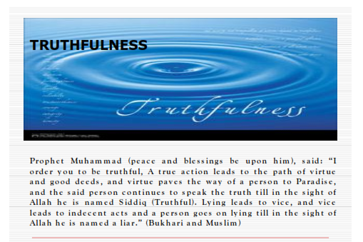
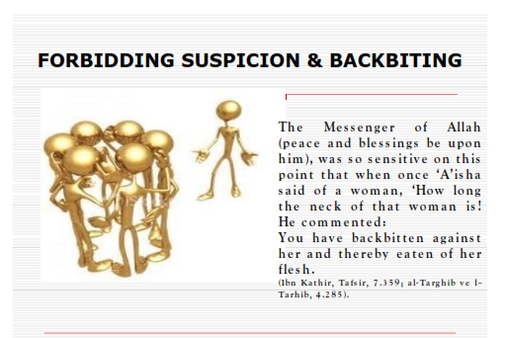
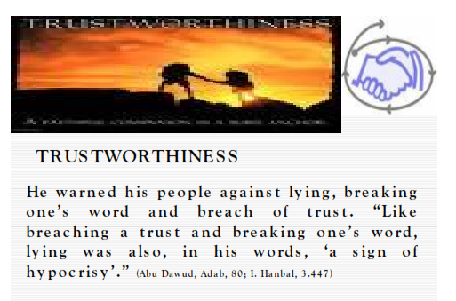

Slide 38
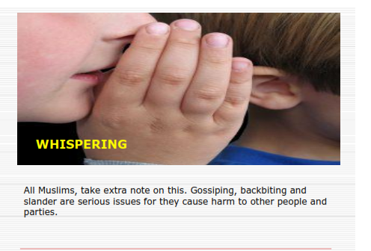
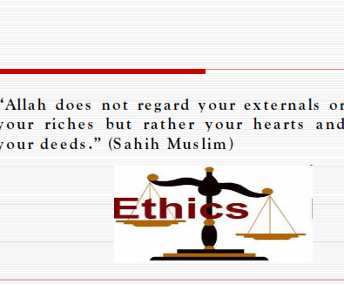
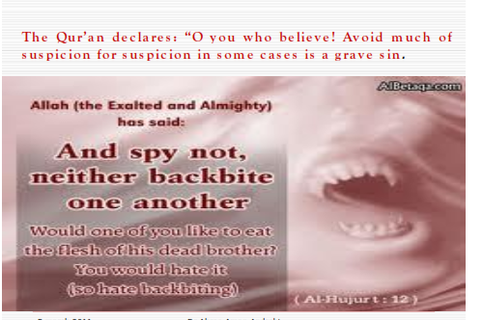

Slide 39
End of Lecture

